Slide 1
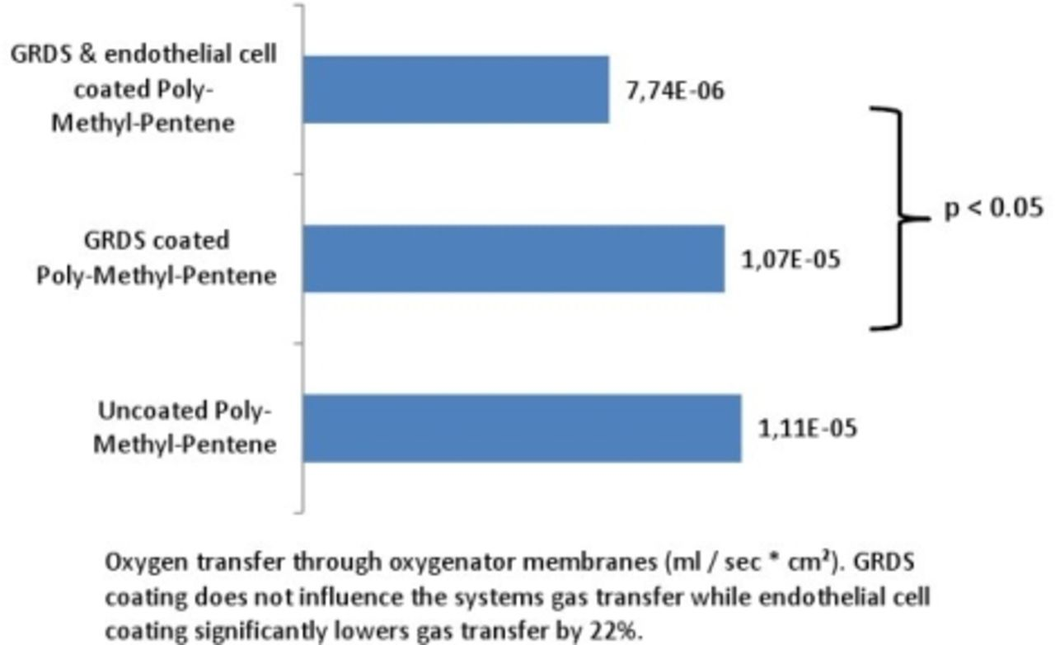
Christian G. Cornelissen et al. Eur Respir J 2014;44:P258
©2014 by European Respiratory Society

